Slide 1

Chapter-17 Agreement of Subject and Verb

Slide 2
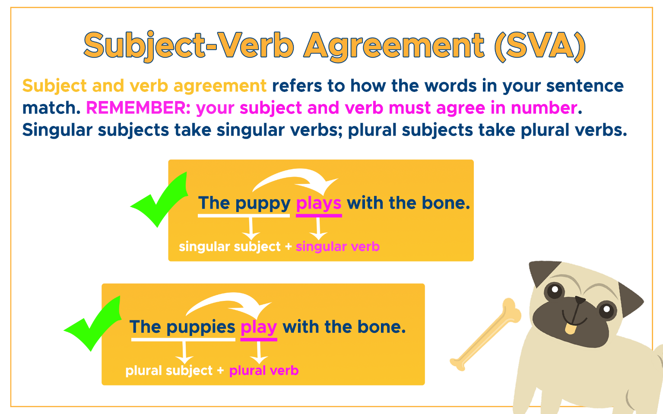
Definition
Agreement or concord happens when a word changes form depending on the other words to which it relates. It is an instance of inflection, and usually involves making the value of some grammatical category "agree" between varied words or parts of the sentence.

Slide 3
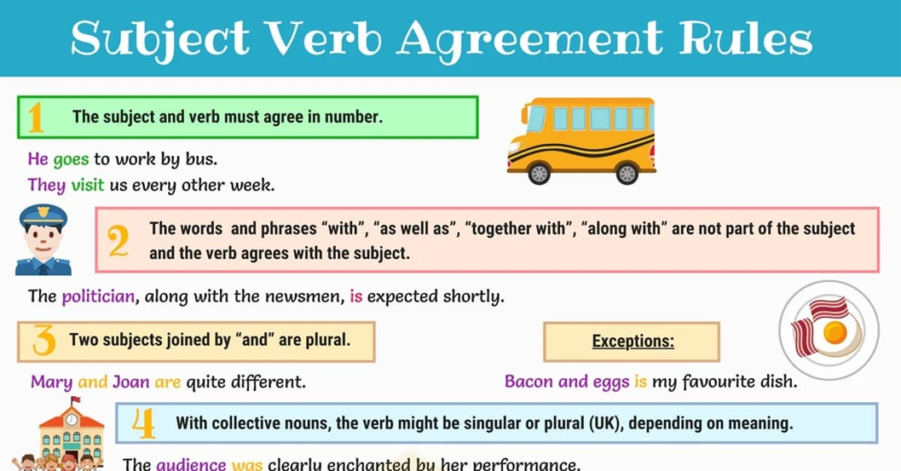

Slide 4
Some Sentence Examples
Ram goes to school everyday.
I take tea every morning.
The dog chases the cat.
The puppy plays with the bone.
The pig eats all day.
The owl sleeps all day.
Maria walks her dog everyday.
It takes a special person to be a clown.
All the children like playing soccer.
Jana sings on the way to school

Slide 5

Question Time

Slide 6
A. Instructions: Read the following sentences and circle the correct verb for each one. Keep in mind that when a compound subject uses “or” or “nor,” the verb should agree with the closest noun.
1. Sally (run, runs) to the park every day.
2. The dogs (bark, barks) at strangers.
3. Ted and Mary (is, are) going to the movies.
4. The game (was, were) exciting.
5. My friends (worry, worries) too much.
6. Olivia (study, studies) every night.
7. Black or white (is, are) your choice.
8. The movie (was, were) incredible.
9. Archery (is, are) my favourite hobby.
10. The cat or dogs (is, are) in the yard.

Slide 7

Answer Time

Slide 8
A. Instructions: Read the following sentences and circle the correct verb for each one. Keep in mind that when a compound subject uses “or” or “nor,” the verb should agree with the closest noun.
1. Runs
2. Bark
3. Are
4. Was
5. Worry
6. Studies
7. Is
8. Was
9. Is
10. Are

Slide 9
Recap
Subject verb agreement means your subject or verb must match or agree.
The word and the phrases “with’’ , “as well as”, “together with”, are not part of
the subject and the verb agrees with the subject.
Two subject joined by “and’’ are plural.
With collective nouns, the verb might be singular or plural, depending on meaning.

Slide 10


